Slide 1
COS 212 String Matching

Slide 2
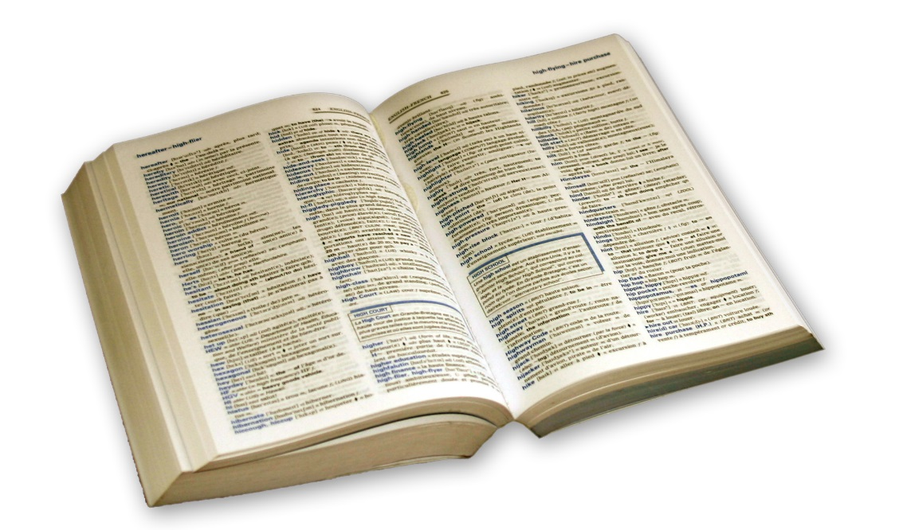
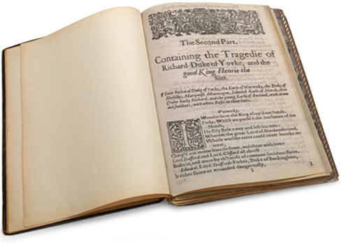
The Problem of Searching
Searching for a key in a data structure is a difficult task
Searching unsorted structures with sequential search: O(n)
Searching sorted structures with binary search: O(lg n)
Searching hash tables allows direct access: O(1)
What if you are looking for a word in a piece of text?
Can text be considered a data structure?

Slide 3

String Matching
Language
The main communication medium of humans
It is too complex for simplistic data structures
String matching
Looking for a particular subset of text in a large text file
What is the fastest way of automating the process?

Slide 4
Differences from Textbook
Take careful note!
The algorithm pseudocode in these slides differs from the pseudocode given in the textbook, due to errors
When answering questions related to these algorithms, you must use the algorithms outlined in these slides
This is especially important for the last approach we discuss (the Knuth-Morris-Pratt algorithm and its findNext method)
The errors in the Knuth-Morris-Pratt algorithm also mean that the textbook’s discussion on the algorithm’s time complexity are inaccurate

Slide 5
Brute Force String Matching
Exact string matching
Find pattern P in text T
Naïve approach
Brute force string matching
Run through T letter-by-letter
At every letter of T, compare P to T letter-by-letter
Reset P each time a mismatch is found
i
i
i
i
i
i
i
i
i
i
i
a
b
c
c
b
T:
P:
a
b
a
b
c
a
a
b
c
a
j
j
j
j
j
bruteForceStringMatching(pattern P, text T)
i = 0; // index for T
while i ≤ |T| - |P| // while P fits into T
j = 0; // index for P
while j < |P| and T_{i} == P_{j}
i++; // try to match all characters in P
j++;
if j == |P| // have we matched the entire P?
return match at i - |P|; // success if the end of P is reached
i = i - j + 1; // mismatch, so move right 1 in T
return no match; // fail if too few characters left in T
Complexity?
O(|T||P|)
Can we do better?

Slide 6
Improving Brute Force
Hancart proposed an improvement to basic brute force
Start comparisons from the second character of P and T
Compare the first character in P and T last
Allows optimisation of how i is updated after a mismatch is found
Optimisation is based on whether 1st two characters in P match
If P₀ != P₁ && T_{i+1} != P₁
Increment index i by one and start search again
If P₀ != P₁ && T_{i+1} == P₁
Look ahead in T, matching P character by character
If we match against all remaining characters in P and T_{i} also matches P₀
Report that a match has been found
If a mismatch is found during the look ahead (e.g. between b and a)
Because T_{i+1} == P₁ and P₀ != P₁, we already know that T_{i+1} != P₀
Increment index i by two and start search again
i
i
T:adabcabcaba… P:abaabd
i
i
T:adabcabcaba… P:cdaabd

Slide 7
Improving Brute Force
Hancart proposed an improvement to basic brute force
If P₀ == P₁ && T_{i+1} != P₁
Because T_{i+1} != P₁ and P₀ == P₁, we already know that T_{i+1} != P₀
Increment index i by two and start search again
If P₀ == P₁ && T_{i+1} == P₁
Look ahead in T, matching P character by character
If we match against all remaining characters in P and T_{i} also matches P₀
Report that a match has been found
If a mismatch is found during the look ahead (e.g. between b and a)
Increment index i by one and start search again
i
i
T:adabcabcaba… P:bbaabd
i
i
T:adabcabcaba… P:ddaabd
Difference from brute force: Sometimes, we can take a step of 2 in the text T instead of 1
Complexity?
O(|T||P|)
(worst case)
Better on average

Slide 8
Knuth-Morris-Pratt Algorithm
Consider the following situation
The first part of P (i.e. abcab) has been matched in T
The last character in P (i.e. a) doesn’t match the last character in P (i.e. d)
Brute force
Shifts one position to the right from the start of the partial match in T
Knuth-Morris-Pratt (KMP) algorithm
Shift as far to the right as possible in T and P
b and c in T can’t match to start of P (so skip them)
ab in T matches to start of P (so skip them in T and P)
i
T:abcaba…
P:abcabd
Brute force
i
j
T:abcaba…
P:abcabd
i
a
KMP algorithm
T:abcaba…
P:abcabd
j
c
j

Slide 9
Knuth-Morris-Pratt Algorithm
How do we know how far to skip ahead?
Here we haven’t found a partial match yet
We can only skip ahead one space in T
Here we have a partial match ending with characters (ab) at start of P
Skip ahead, match from after characters (ab) at the end of partial match
Here we have a partial match not ending with characters at start of P
We can skip over the entire partial match, begin again from start of P
T:banana
P:abcabd
T:abcabdab…
P:abcabbd
abcabbd (move P three spaces to the right)
T:axyzdab…
P:axyzbd
axyzbd (Move P four spaces to the right)

Slide 10
Knuth-Morris-Pratt Algorithm
T:abcabdab…
T:axyzdab…
To skip the appropriate number of characters
We need to know if the start of P matches the end of P
Proper prefix
All the characters in a string, with one or more cut off the end
Proper suffix
All the characters in a string, with one or more cut off the start
P:abcabbd
P:axyzbd
abcabbd (skip 3 spaces)
axyzbd (skip 4 spaces)
apple
apple
appl
pple
app
Proper prefixes of apple
ple
Proper suffixes of apple
ap
le
a
e

Slide 11
Knuth-Morris-Pratt Algorithm
The Knuth-Morris-Pratt algorithm requires pre-processing of P
We construct a table with a column for each character in P
For each column j in the table
Consider only characters in P that are before j (substring P[0] to P[j-1])
Store the length of the longest proper prefix matching a proper suffix
−1 if j = 0
max { k: 0 < k < j and P[0 … k −1] = P[ j − k … j − 1] } if such a k exists
0 otherwise
next[ j ] =
P:
j:
next:
a a b a a c a a b d
1
2
3
4
5
6
7
8
9
0
-1
0
1
0
1
2
0
1
2
3
j = 1:
0 < k < 1
j = 2: aa
prefixes in a: a
suffixes in a: a
j = 3: aab
prefixes in aa: a, aa
suffixes in ab: b, ab
j = 4: aaba
prefixes in aab: a, aa, aab
suffixes in aba: a, ba, aba
j = 5: aabaa
prefixes in aaba: a, aa, aab, aaba
suffixes in abaa: a, aa, baa, abaa

Slide 12
Knuth-Morris-Pratt Algorithm
Knuth-Morris-Pratt algorithm
Adapted from the brute force algorithm
Main difference
Partial match table next[] is used to move j in P when mismatch occurs
i never backtracks (meaning i only ever increments by 1)
P:
j:
next[j]:
a b c a b d
0
-1
1
2
3
4
5
0
0
0
1
2
KnuthMorrisPratt(P, T)
findNext(P,next); // populate next[]
i = j = 0;
while i - j ≤ |T| - |P| // P can still fit in T
while j == -1 or (j < |P| and T_{i} == P_{j})
i++;
j++; // match in T from i
if j == |P| // successful match
return match at i - |P|;
j = next[j]; // skip matched part of P
// i does not backtrack
return no match;
i
i
i
i
i
i
i
i
i
i
i
i
a
b
a
b
c
a
b
c
a
b
d
c
T:
P:
a
b
c
a
b
d
j
j
j
j
j
j
j
j = next[2]
j = next[5]
Complexity of KnuthMorrisPratt(P, T)?
O(|T|)

Slide 13
Knuth-Morris-Pratt Algorithm
Populating the next[] array
Match prefixes and suffixes within P itself
We can adapt Knuth-Morris-Pratt
Suffix uses index i, prefix uses index j
After a mismatch, rewind prefix index (j) to start matching with a new suffix
Store length of matches in next[] array
P:
i:
next[i]:
a b c a b d
0
1
2
3
4
5
-1
0
0
0
1
2
findNext(P, next)
next[0] = -1; // next[0] is always -1
i = 0; // suffix counter
j = -1; // prefix counter
while i < |P| - 1 // stop when next[] populated
while j == -1 or (i < |P| - 1 and P_{i} == P_{j})
i++;
j++; // match prefix to suffix
next[i] = j; // j is 0 or a match length
j = next[j]; // rewind j
i
i
i
i
i
i
a
b
c
a
b
d
P:
P:
a
b
c
a
b
d
j
j
j
j
next[1] = 0
j = next[0]
next[2] = 0
next[3] = 0
next[4] = 1
next[5] = 2
j = next[2]
Complexity of findNext(P, next)?
O(|P|)
Overall complexity?
O(|T|+|P|)

